Slide 1
Living the dream
Real world DevOps with Azure and VSTS

Slide 2
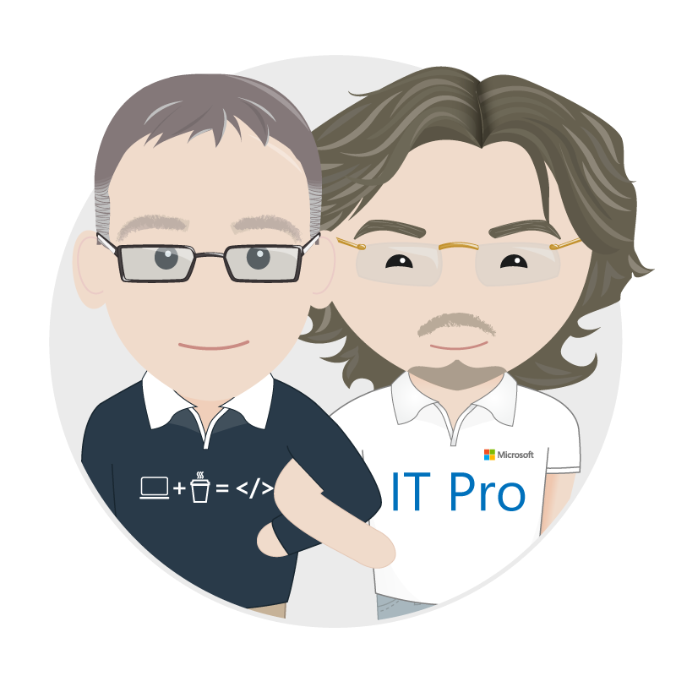

Who are we?
Richard Fennell
@richardfennell
Rik Hepworth
@rikhepworth

Slide 3






The consequences of inefficiency
IT drives business
success!
High IT performance correlates with strong business performance, helps boost productivity, market share and profit.
collaborate
40
%
… of implementations end up getting reworked because they don’t meet the users’ original requirements
Outperforming teams are
54
%
more likely to
extensively
41
%
… of development budgets for software, IT staff and external professional services will be consumed by poor requirements
with their
Collaboration blockers
counterparts
80
%
failure rate …
26.7% No executive support
56.7% Cultural inhibitors
43.3% Fragmented processes
… for companies that try to adapt their existing tools for DevOps practices
Developers
IT Ops
%
Business
70
o
f
CIOs
Would increase risk
1 in
6
It takes on average 200 minutes to diagnose and repair a production issue
IT decision makers is still unfamiliar with the term DevOps
to reduce IT costs
and accelerate business agility
3/4
of teams
DevOps was being initiated by more development teams than IT Ops teams by about a 40% to 33% margin
The average hourly cost of infrastructure failure is $100,000 per hour
100x more
A bug caught in production ends up costing
than if the same bug was found earlier in the development cycle
Responding to ongoing needs for efficiency and growth
Always keeping all systems safe and secure
have adopted
Agile methodologies
dual goals
Notes:
In the real world, there are real consequences if you are unable to deliver high-quality software quickly:
40% of implementations end up getting reworked because they don’t meet the users’ original requirements
The average cost of one hour downtime of a customer-facing app is calculated at $100,000 per hour – and this does not take into account the damage to reputation, which can be even greater. Fixing such production issues takes on average 200 minutes per incident
Three quarters of development teams have adopted Agile methodologies today, enabling them to develop faster. While this is a great number, it does not help if a Development team is Agile but deployment still takes weeks or months because IT Ops is perceived as not being Agile
These are just 3 very high-level examples but all the data we have today points toward the same conclusion – this is about more than just frustration or minor delays
Lack of collaboration between dev and ops can have substantial impact on a company’s bottom line and success

Slide 4
Agenda: Walking through the software process
Dev
Build
Deploy to Lab
Test
Deploy to Production

Slide 5




Agenda: Walking through the software process
Deploy to QA
Develop
Deploy to Lab
Build

Slide 6

Walkthrough

Slide 7
Summary
DevOps is a process not a technology solution
Your steps may differ
No one tool will solve everything
Configuration as code is a key enabler for automation
Essential for cloud; useful for on-prem

Slide 8
Useful Links:
Black Marble custom VSTS Extensions: http://bit.ly/VSTSBM
Colin’s ALM Corner custom build and release Extension: http://bit.ly/VSTSCOLALM
Our Githubs: https://github.com/rikhepworth/ https://github.com/rfennell
Our blogs: http://blogs.blackmarble.co.uk

Slide 9
Thanks for listening
Richard Fennell
@richardfennell
Rik Hepworth
@rikhepworth

Slide 11
Backup Slides
Living the dream: Real world DevOps with Azure and VSTS

Slide 12
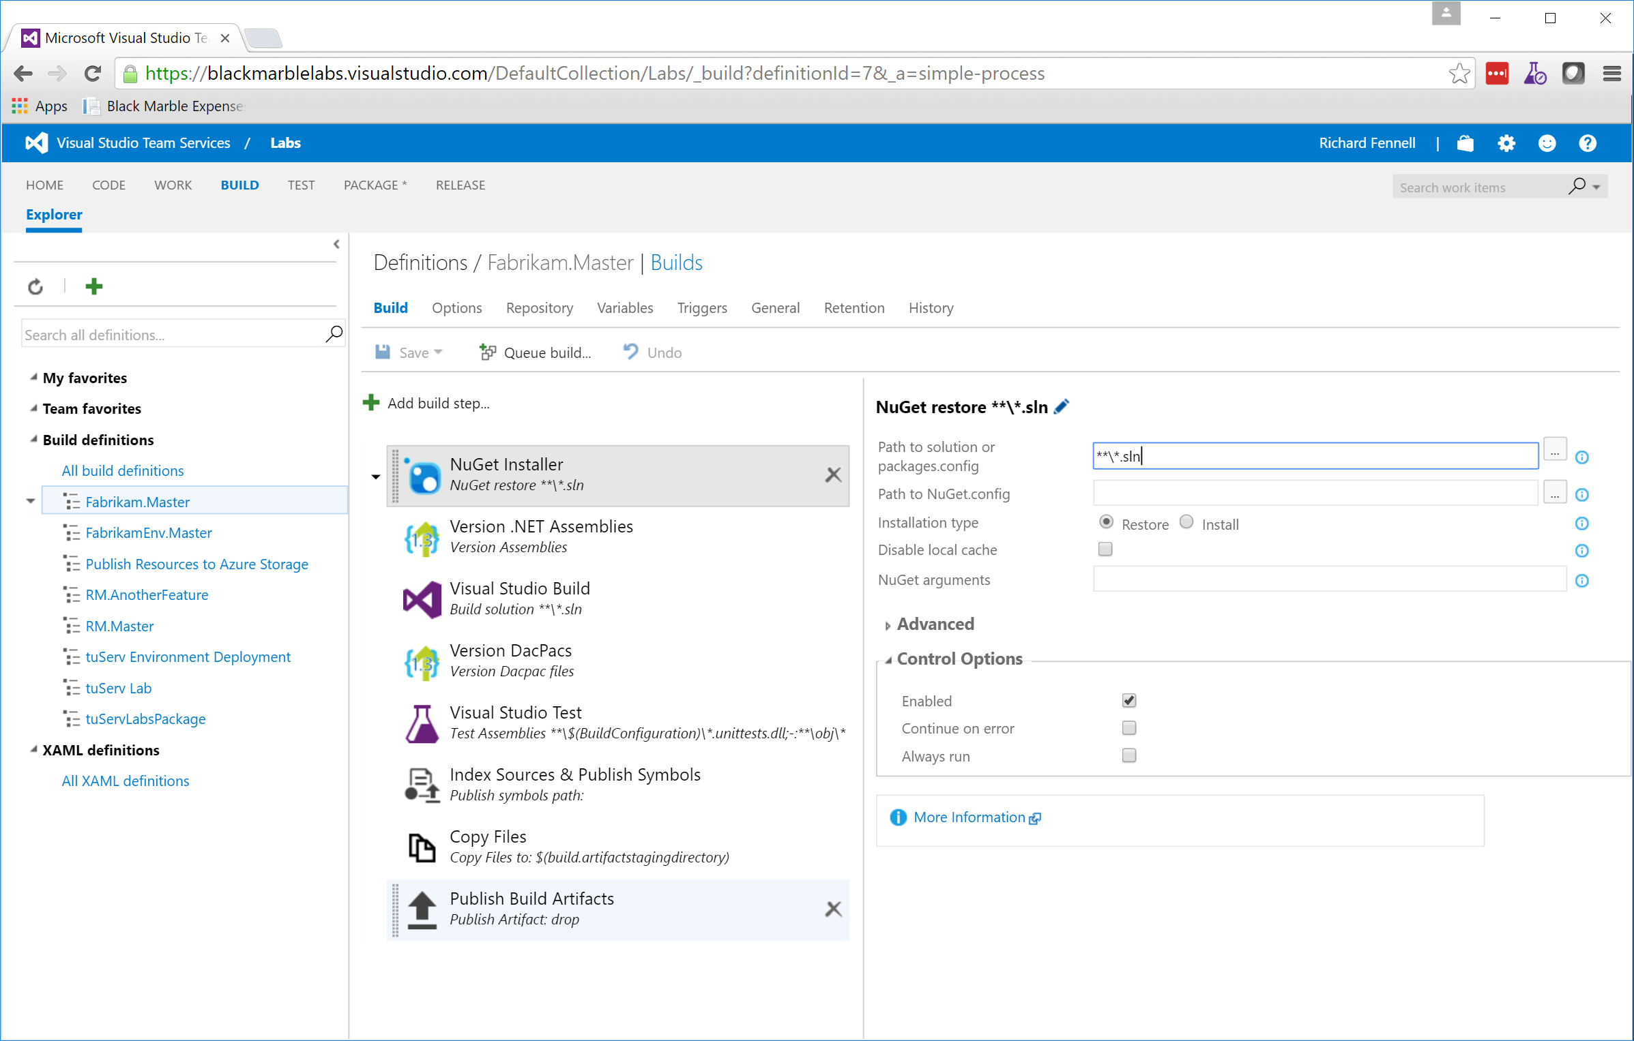

Slide 13
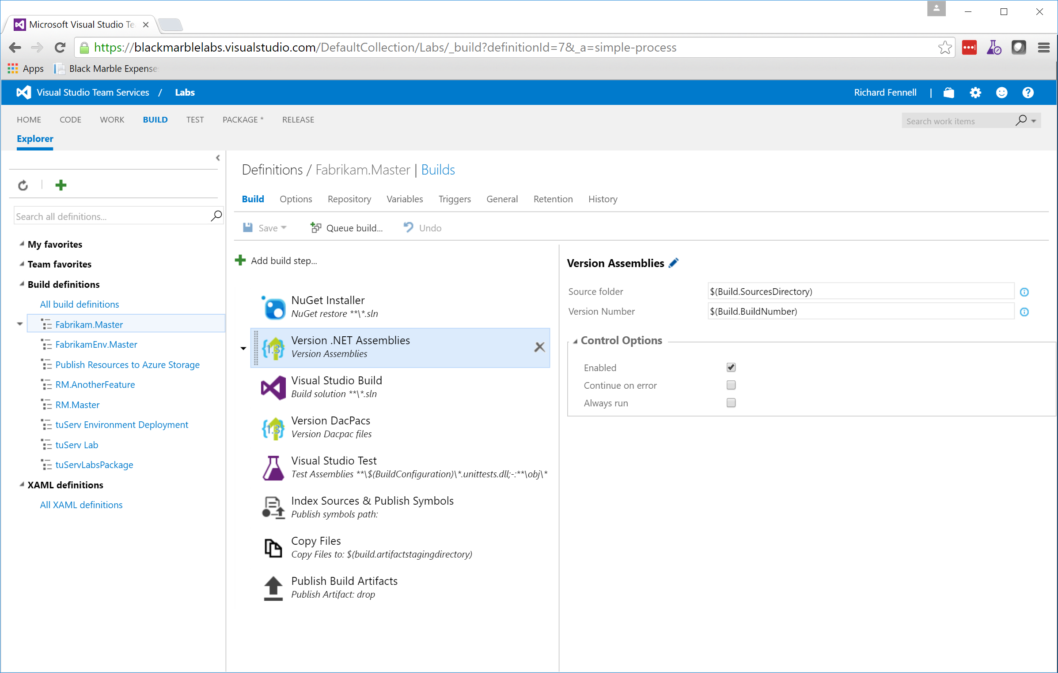

Slide 14
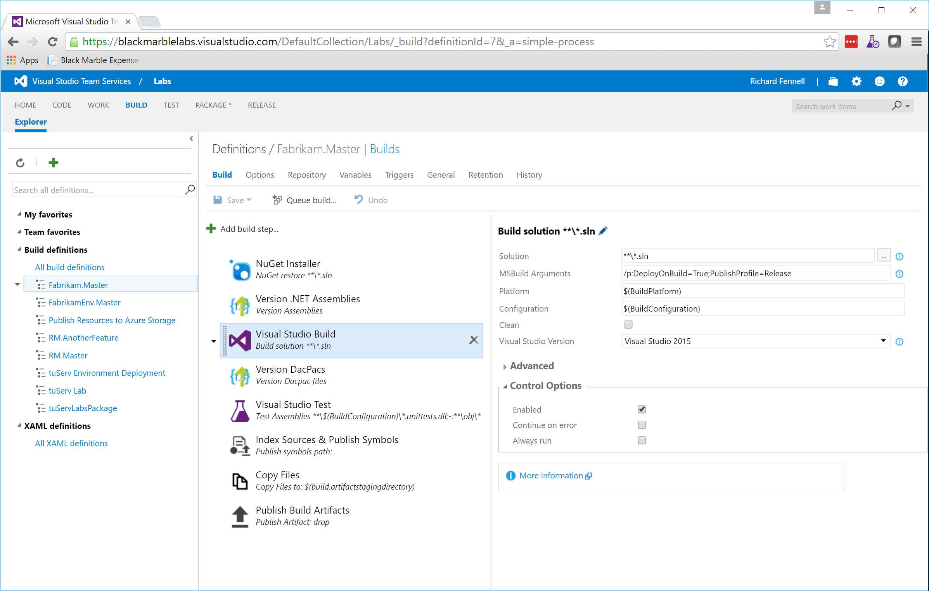

Slide 15
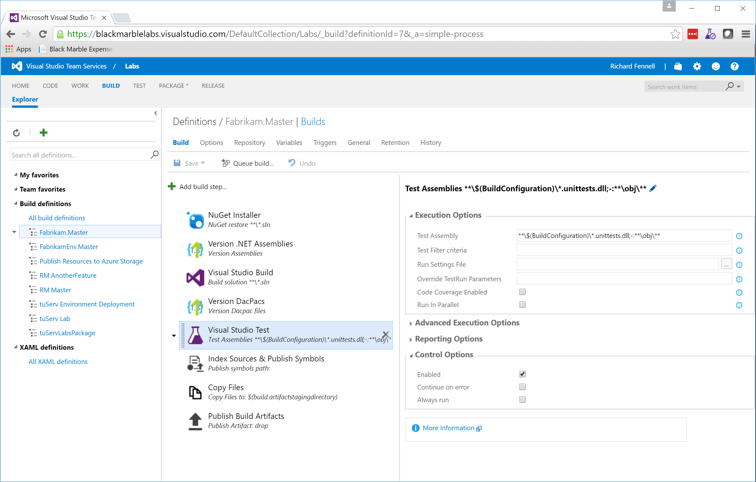

Slide 16
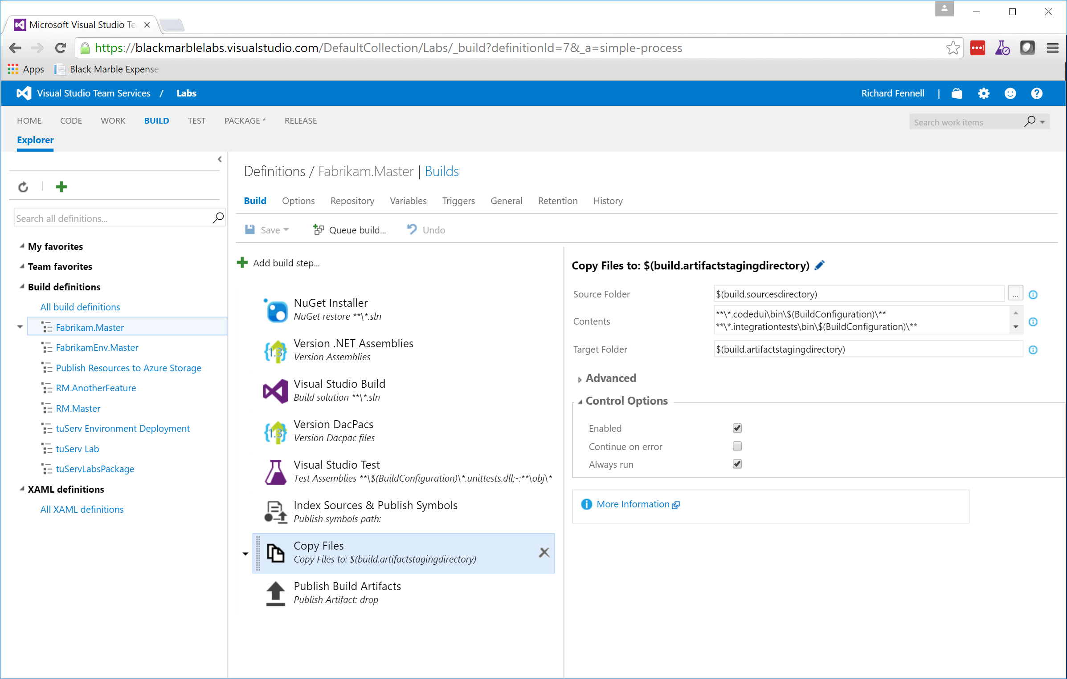

Slide 17
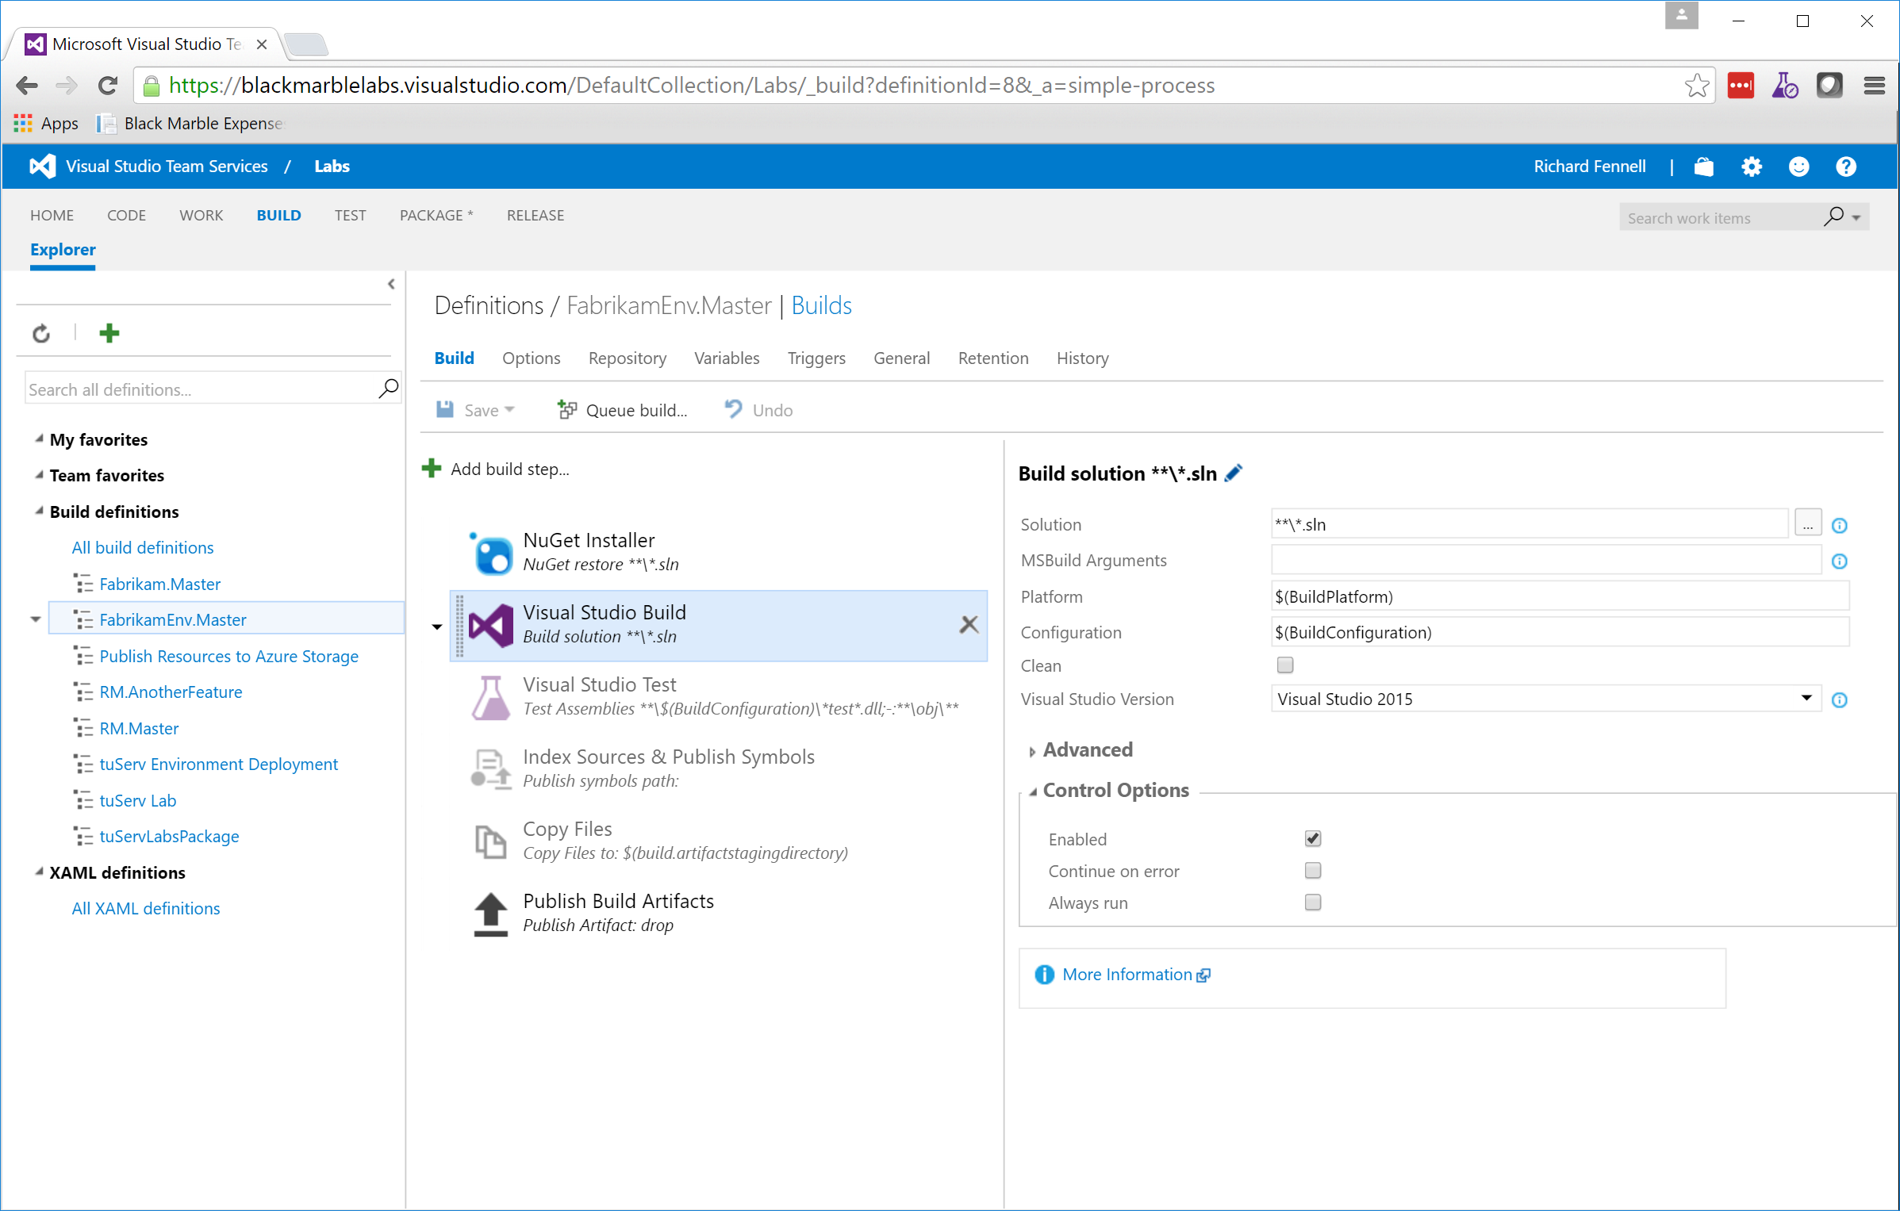

Slide 18
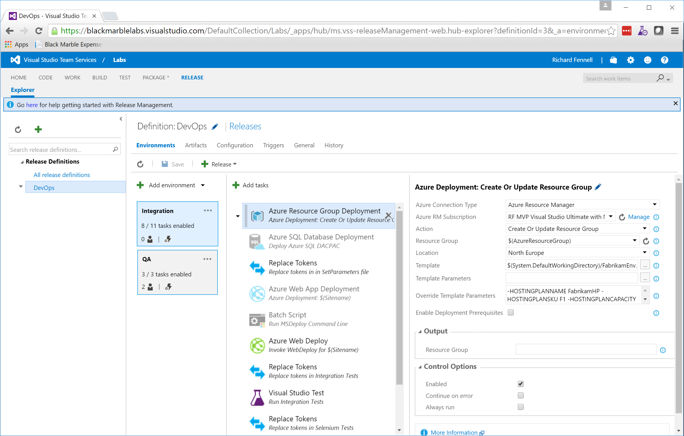

Slide 19
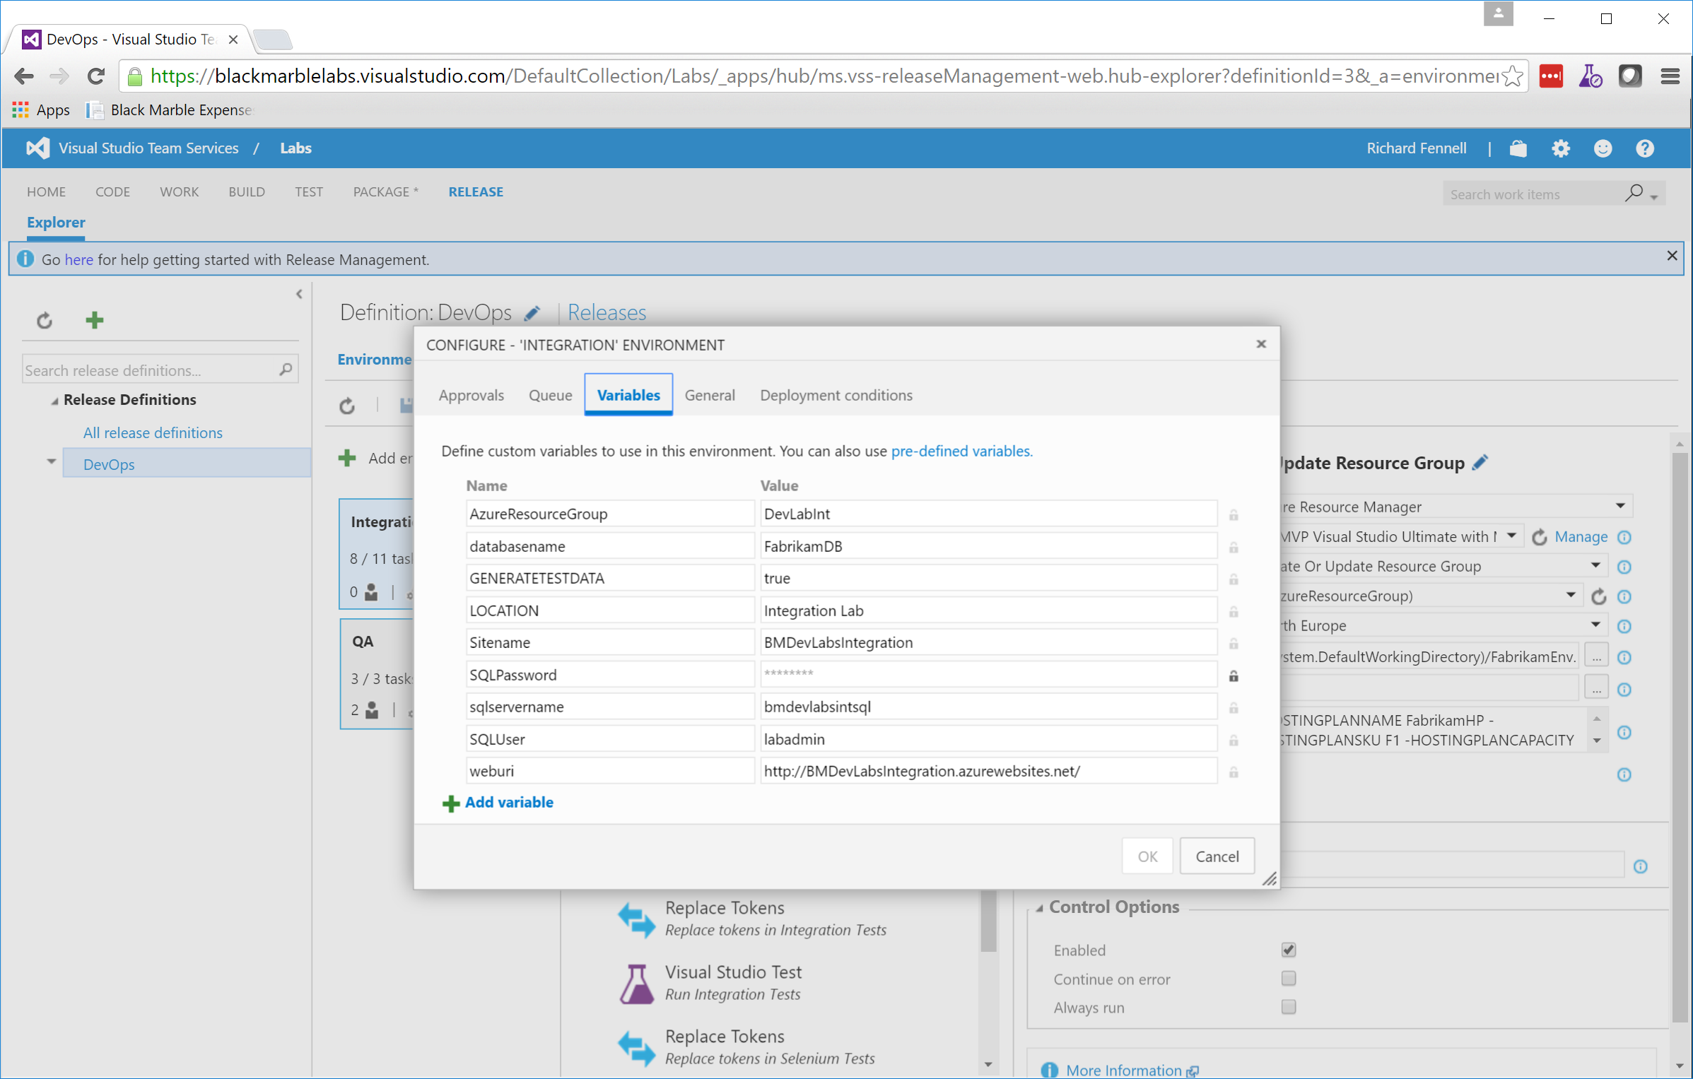

Slide 20
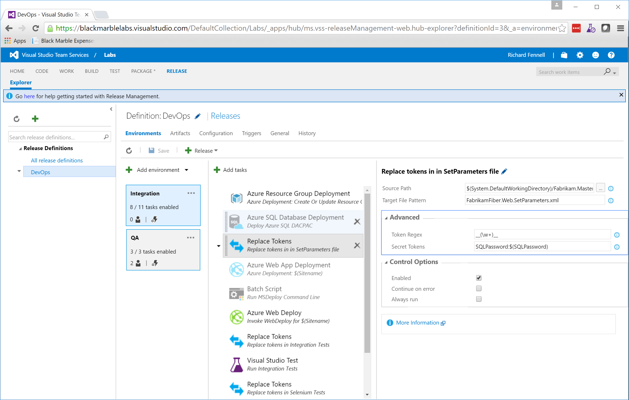

Slide 21
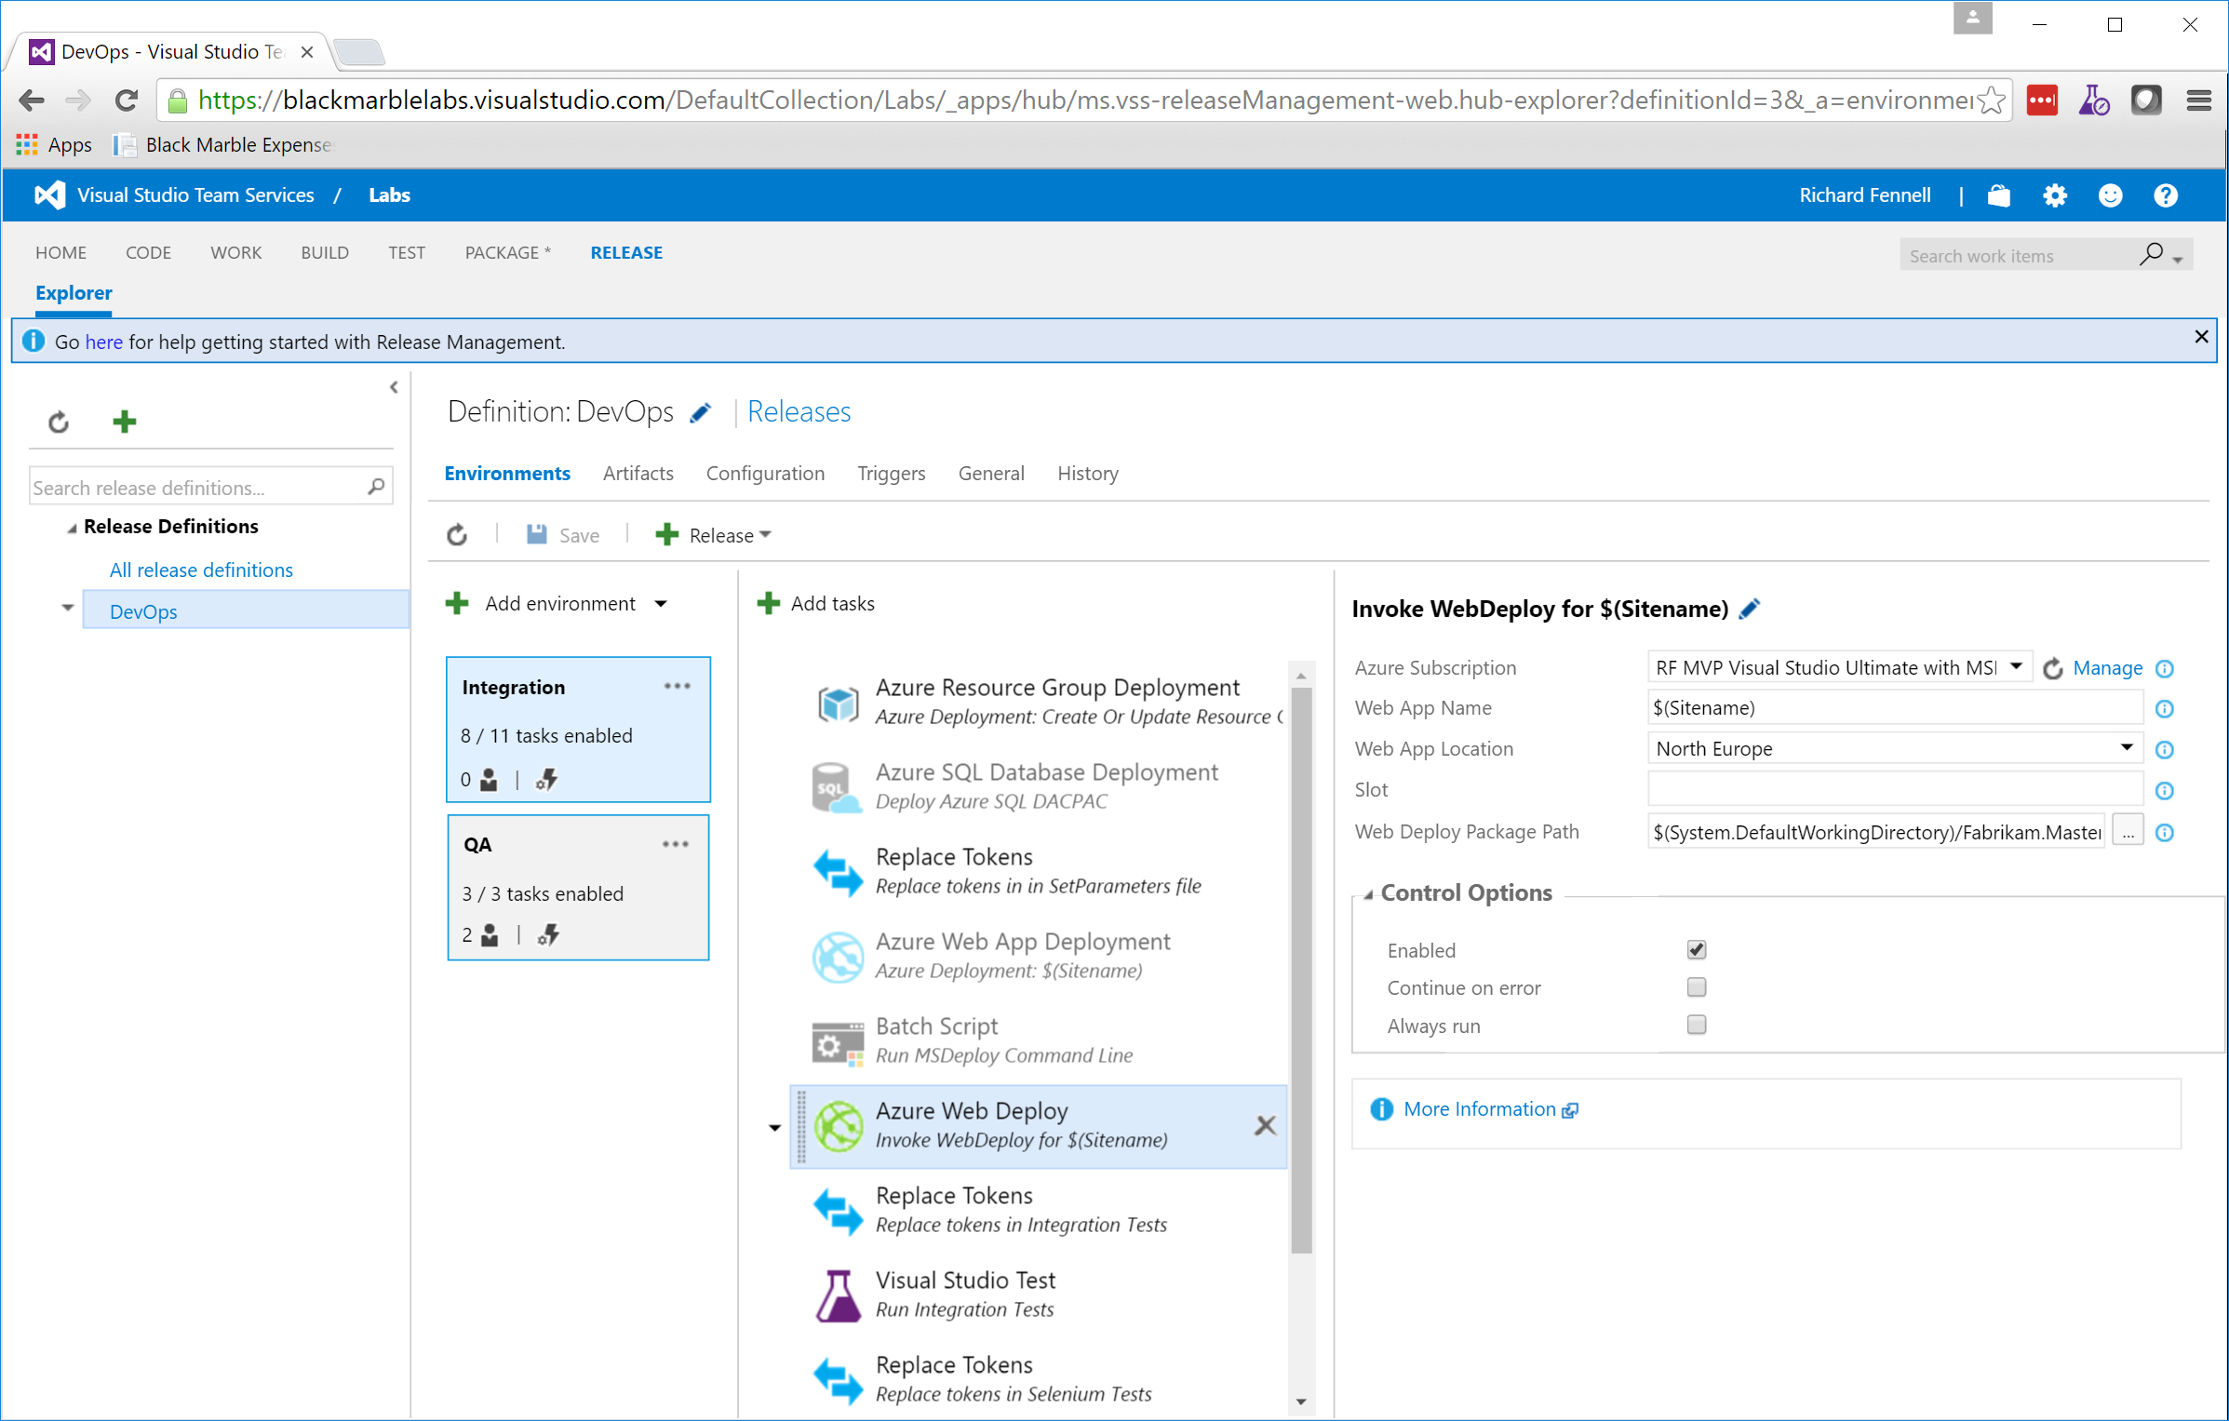

Slide 22
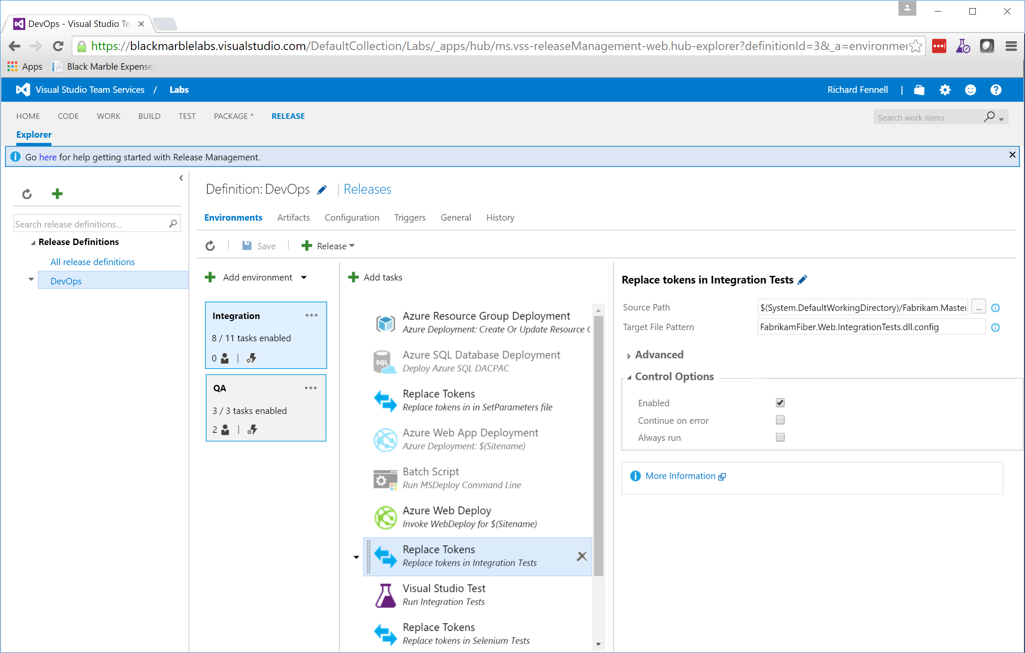

Slide 23
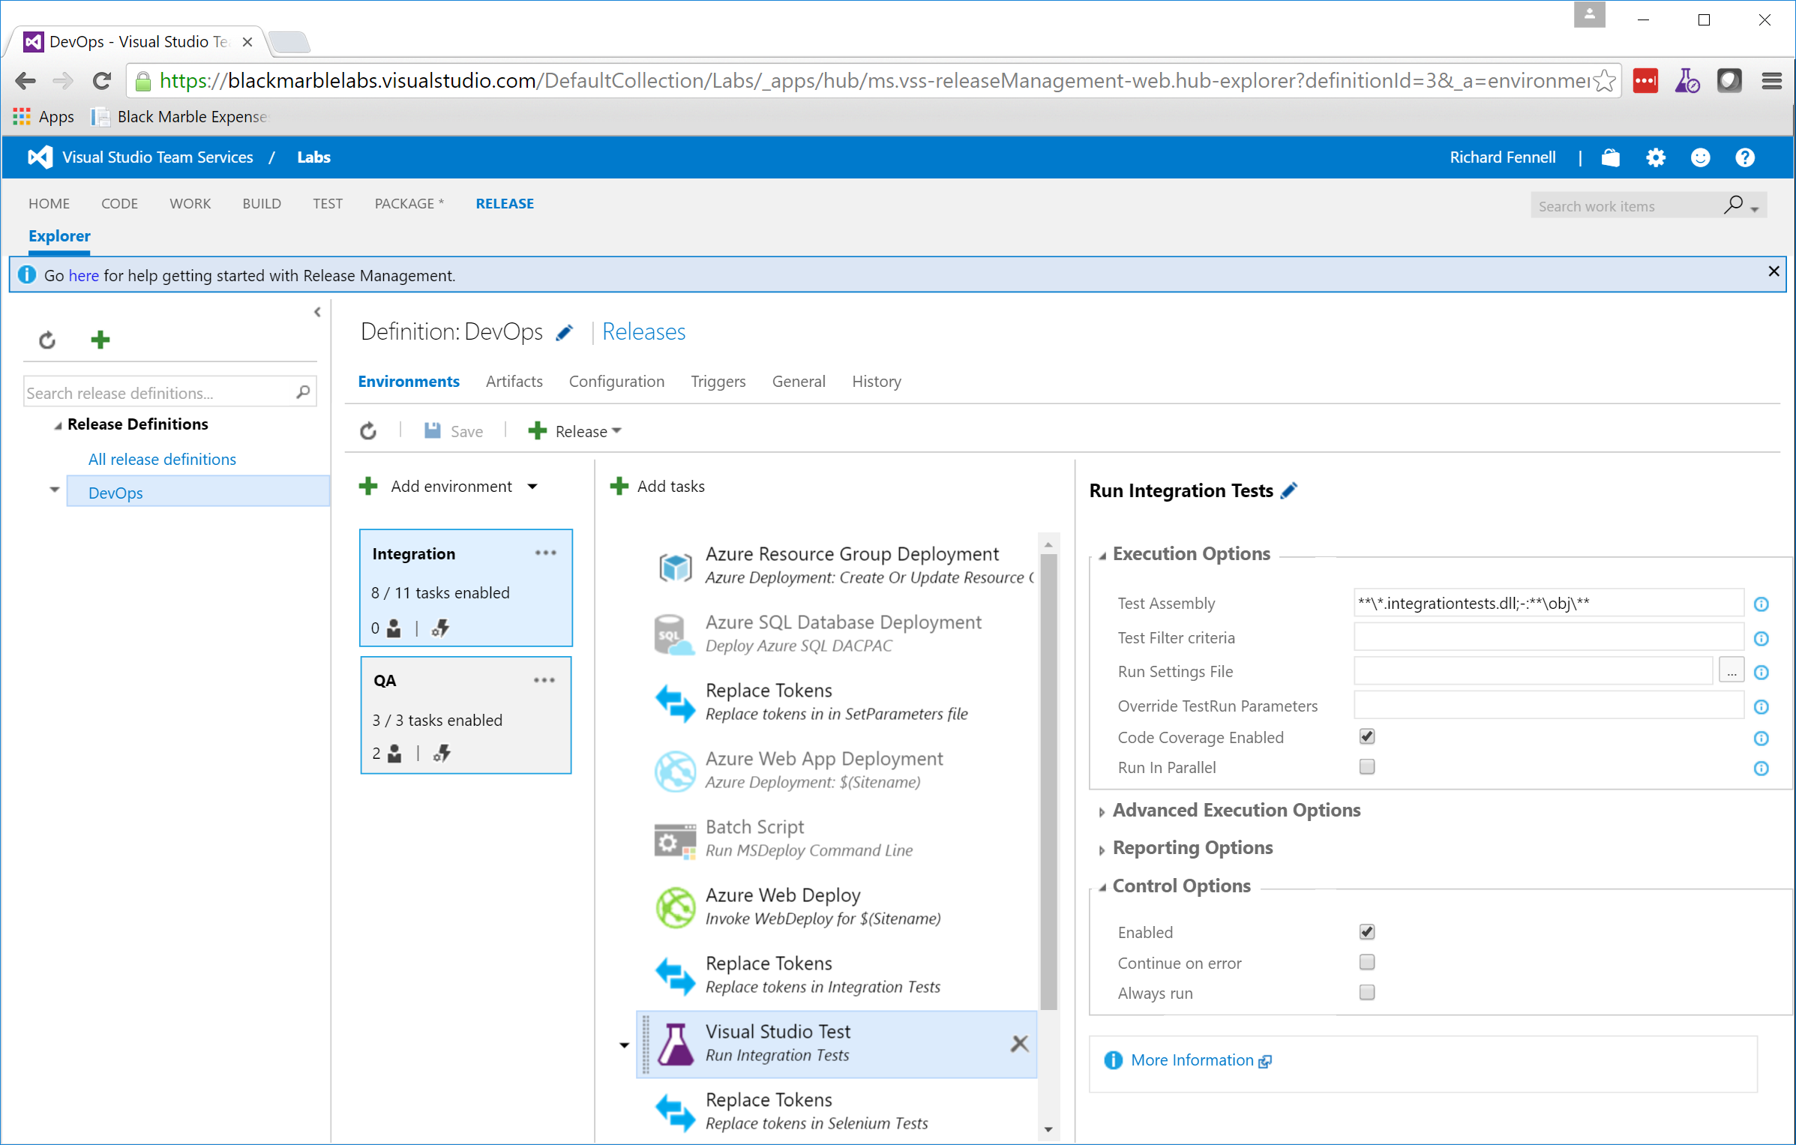

Slide 24
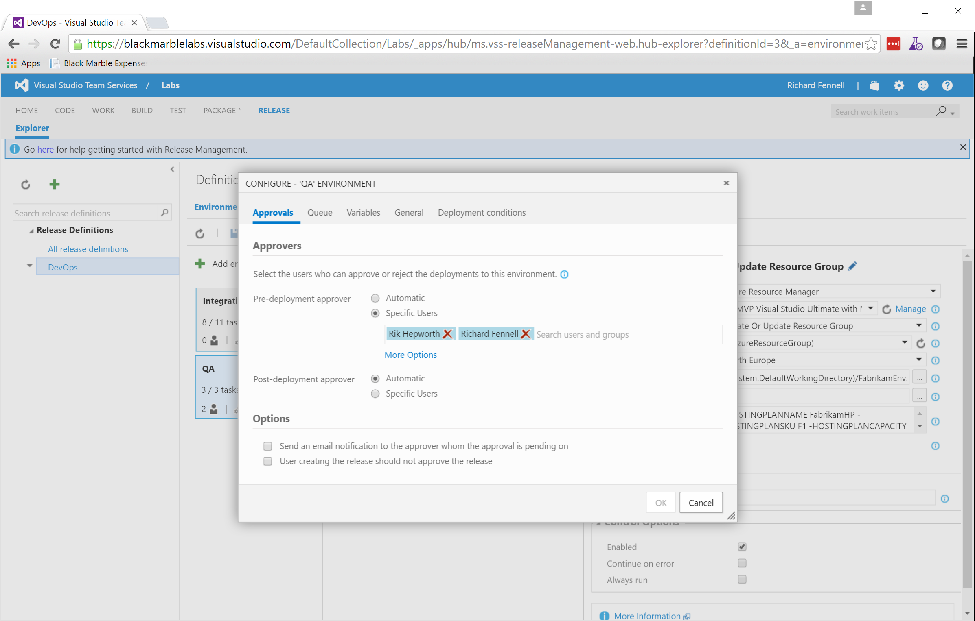

Slide 25
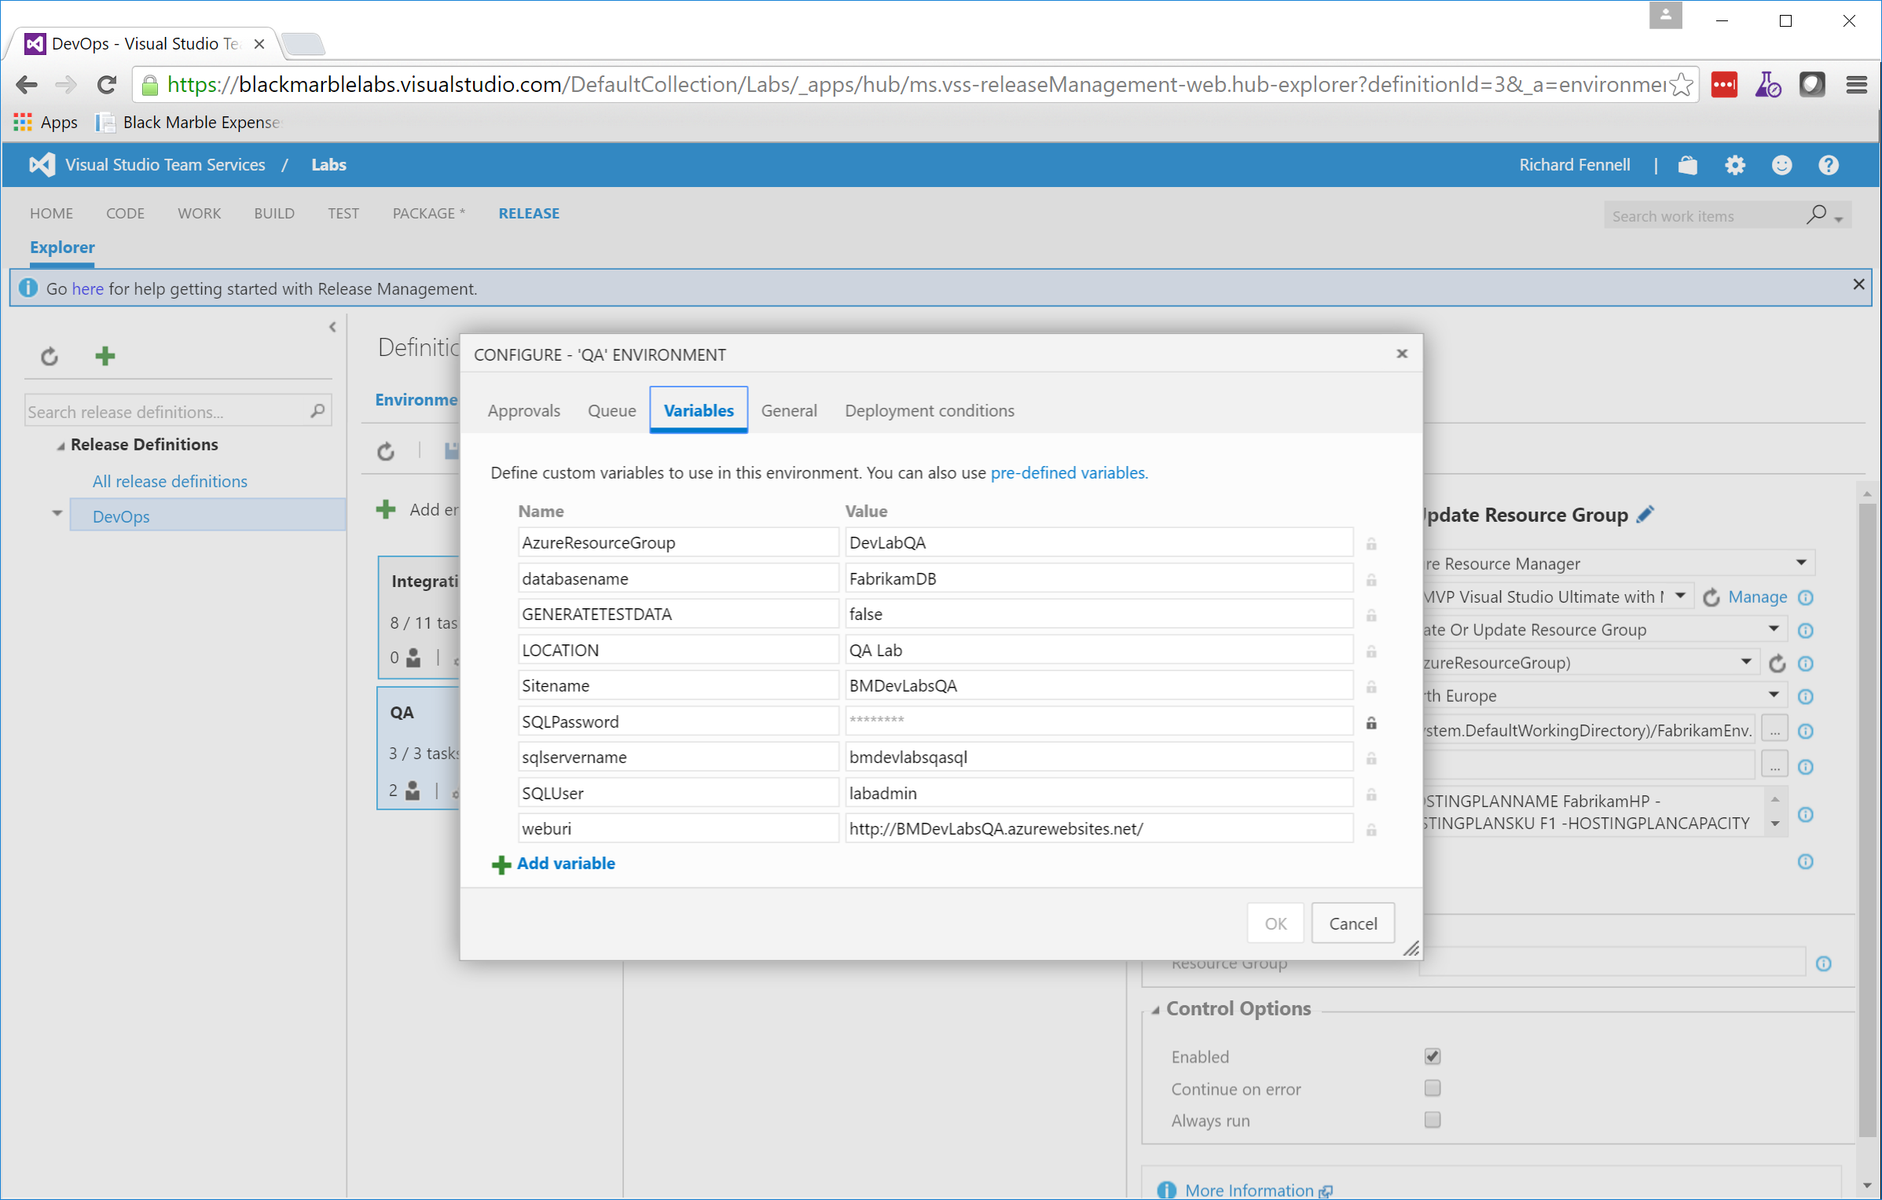

Slide 26
